Slide 1
SQL Server Security Model

Slide 2
Overview
Starting SQL Server 2005, Microsoft began using the terminology called Server Principal for Login and Database Principal for User
Server Principals or Logins : Provides access to connect to SQL Server-Level
Database Principals or User : Provides access within a Database Level
Note : only one user per database can be associated to a Login but login can be associated to a user in different databases.

Slide 3
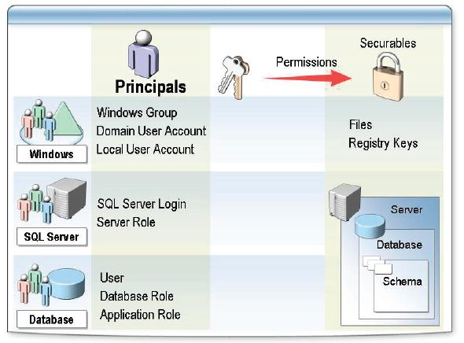
Security Hierarchy

Slide 4
Types of Authentication
Windows Authentication Mode:
With Windows authentication, you do not have to specify a login name and password, to connect to SQL Server. Instead, your access to SQL Server is controlled by your Windows account . (or the group to which your account belongs to), that you used to login to the Windows operating system on the client computer/workstation. A DBA must first specify to SQL Server, all the Microsoft Windows accounts or groups that can connect to SQL Server

Slide 5
Authentication
Mixed mode:
Mixed mode allows users to connect using Windows authentication or SQL Server authentication. DBA must first create valid SQL Server login accounts and passwords. These are not related to Microsoft Windows accounts. With this authentication mode, you must supply the SQL Server login and password when you connect to SQL Server.

Slide 6
Two Levels of Authentication
  SQL Server level (Logins)
A valid login name is required to connect to an SQL Server instance. A login could be:
  A Windows login that has been granted access to SQL Server
  An SQL Server login, that is maintained within SQL Server
Database level (User Accounts)
  A valid user account within a database is required to access that database. User accounts are specific to a database. All permissions and ownership of objects in the database are controlled by the user account. SQL Server logins are associated with these user accounts.

Slide 7
Stored Procedures for Managing Logins and Users
sp_addlogin
Creates a new login that allows users to connect to SQL Server using SQL Server authentication
sp_grantlogin
Allows a Windows user account or group to connect to SQL Server using Windows authentication
sp_droplogin
Drops an SQL Server login
sp_revokelogin
Drops a Windows login/group from SQL Server

Slide 8
Stored Procedures for Managing Logins and Users
sp_denylogin
Prevents a Windows login/group from connecting to SQL Server
sp_password
Adds or changes the password for an SQL Server login
sp_helplogins
Provides information about logins and their associated users in each database
sp_defaultdb
Changes the default database for a login

Slide 9
Stored Procedures for Managing Logins and Users
sp_grantdbaccess
Adds an associated user account in the current database for an SQL Server login or Windows login
sp_revokedbaccess
Drops a user account from the current database
sp_helpuser
Reports information about the Microsoft users and roles in the current database

Slide 10
Types of Roles
Fixed server roles
These are server-wide roles. Logins can be added to these roles to gain the associated administrative permissions of the role. Fixed server roles cannot be altered and new server roles cannot be created.
Sysadmin
Can perform any activity in SQL Server
Serveradmin
Can set server-wide configuration options, shut down the server.

Slide 11
Fixed Server Roles
Setupadmin
Can manage linked servers and startup procedures
Securityadmin
Can manage logins and CREATE DATABASE permissions, also read error logs and change passwords
Processadmin
Can manage processes running in SQL Server
Dbcreator
Can create, alter, and drop databases

Slide 12
Fixed Server Roles
Diskadmin
Can manage disk files
Bulkadmin
Can execute BULK INSERT statements

Slide 13
Stored Procedures for Managing Fixed Server Roles
sp_addsrvrolemember
Adds a login as a member of a fixed server role
sp_dropsrvrolemember
Removes an SQL Server login, Windows user or group from a fixed server role
sp_helpsrvrole
Returns a list of the fixed server roles
sp_helpsrvrolemember
Returns information about the members of fixed server roles

Slide 14
Stored Procedures for Managing Fixed Server Roles
sp_srvrolepermission
Returns the permissions applied to a fixed server role

Slide 15
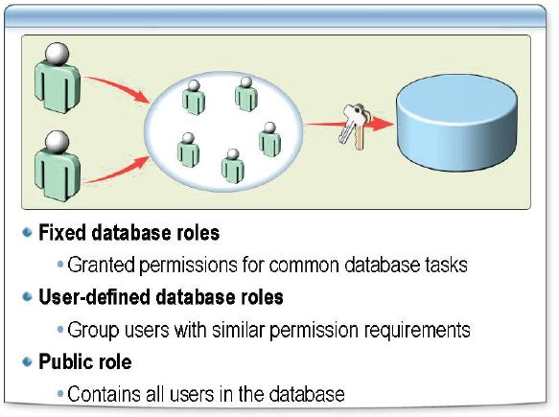
Database Roles

Slide 16
Fixed Database Roles
db_owner
Has all permissions in the database
db_accessadmin
Can add or remove user IDs
db_securityadmin
Can manage all permissions, object ownerships, roles and role memberships
db_ddladmin
Can issue ALL DDL, but cannot issue GRANT, REVOKE, or DENY statements

Slide 17
Fixed Database Roles
db_backupoperator
Can issue DBCC, CHECKPOINT, and BACKUP statements
db_datareader
Can select all data from any user table in the database
db_datawriter
Can modify any data in any user table in the database
db_denydatareader
Cannot select any data from any user table in the database

Slide 18
Fixed Database Roles
db_denydatawriter
Cannot change data in any table
Public
Maintain default permissions

Slide 19
Stored Procedures for Managing Fixed Database Role
sp_addrole
Creates a new database role in the current database
sp_addrolemember
Adds a user to an existing database role in the current database
sp_dbfixedrolepermission
Displays permissions for each fixed database role
sp_droprole
Removes a database role from the current database

Slide 20
Stored Procedures for Managing Fixed Database Role
sp_helpdbfixedrole
Returns a list of fixed database roles
sp_helprole
Returns information about the roles in the current database
sp_helprolemember
Returns information about the members of a role in the current database
sp_droprolemember
Removes users from the specified role in the current database

Slide 21
Application Roles
Application roles are another way of implementing permissions. After creating and assigning the required permissions to an application role, the client application needs to activate this role at run-time to get the permissions associated with that application role. Application roles simplify the job of DBAs, as they don't have to worry about managing permissions at individual user level. All they need to do is to create an application role and assign permissions to it. The application that is connecting to the database activates the application role and inherits the permissions associated with that role.

Slide 22
Characteristics of Application Roles
There are no built-in application roles
Application roles contain no members
Application roles need to be activated at run-time.
Application roles override standard permissions.
Application roles are database specific.

Slide 23
Stored Procedures for Managing Application Roles
sp_addapprole
Adds an application role in the current database
sp_approlepassword
Changes the password of an application role in the current database
sp_dropapprole
Drops an application role from the current database
sp_setapprole
Activates the permissions associated with an application role in the current database

Slide 24
Securables
Securables are the resources to which the SQL Server Database Engine authorization system regulates access. Some securables can be contained within others, creating nested hierarchies called "scopes" that can themselves be secured.
Server
Database
Schema

Slide 25
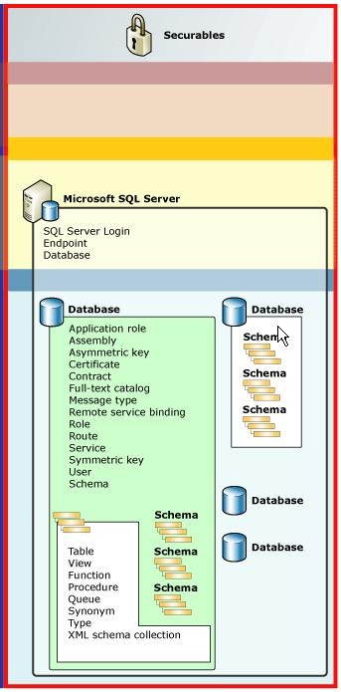
Securable scope

Slide 26
Securable scope: Server
Contains the following securables:
Endpoint
Login
Database

Slide 27
Securable scope: Database
Contains the following securable:
User
Role
Application role
Assembly
Message Type
Route
Service

Slide 28
Securable scope: Database
Remote Service Binding
Fulltext Catalog
Certificate
Asymmetric Key
Symmetric Key
Contract
Schema

Slide 29
Securable scope: Schema
Contains the following securable:
Type
XML Schema Collection
Object

Slide 30
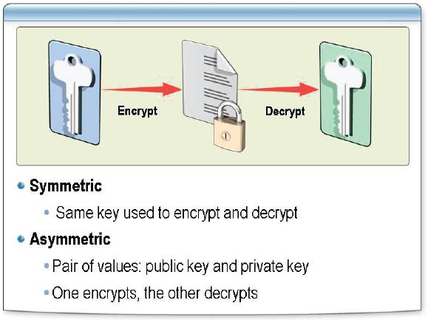
Keys

Slide 31
Keys
Symmetric Keys: A symmetric key is a value that is used to both encrypt and decrypt data. When a symmetric key is used, it must be shared by both the person or system encrypting the data and the person or system decrypting the data. SQL Server supports symmetric keys fordata encryption
Asymmetric Keys: Asymmetric keys consist of a pair of values that can be used in a one-way arithmetic function in such a way that data can be encrypted with one value and decrypted with the other. Asymmetric key pairs consist of a public key, which can be shared publicly, and a private key, which must be kept secure by the key owner. Data encrypted with the public key can be decrypted with the private key.

Slide 32
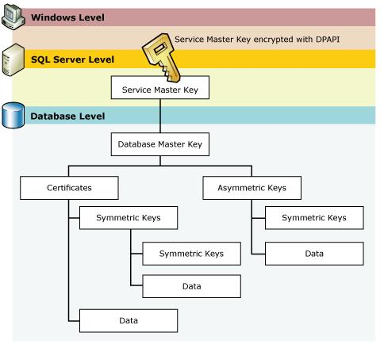
Encryption Mechanisms

Slide 33
Auditing
Auditing an instance of SQL Server or a SQL Server database involves tracking and logging events that occur on the system. An important part of any security solution is the ability to audit actions for accountability and regulatory compliance reasons. which enables administrators to capture activity in the database server and store it in a log.
File
Windows Application Log
Windows Security Log

Slide 34
Triggers
DDL Triggers
DDL triggers, like regular triggers, fire stored procedures in response to an event. However, they fire in response to a variety of Data Definition Language (DDL) statements. DDL triggers can be used for administrative tasks such as auditing and regulating database operations.
DML triggers
DML triggers execute when a user tries to modify data through a data manipulation language (DML) event. DML events are INSERT, UPDATE, or DELETE statements on a table or view

Slide 35
Best Practices
Rename the sa account
Use strong passwords
No one should log on as sa
Use least-privilege accounts for SQL Services
Audit principals regularly
Disable or remove any unused network protocols
Use on-the-wire encryption to protect your data in transit

Slide 36
Best Practices
Do not place the SQL Server in a location with poor physical security
Minimize the visibility of the server
Remove or disable unnecessary services and applications
Use Windows Authentication whenever possible
Understand your role in the company’s security policy

Slide 37
Thank You

